Slide 1

SCSA1602 - NETWORK SECURITY

Slide 2
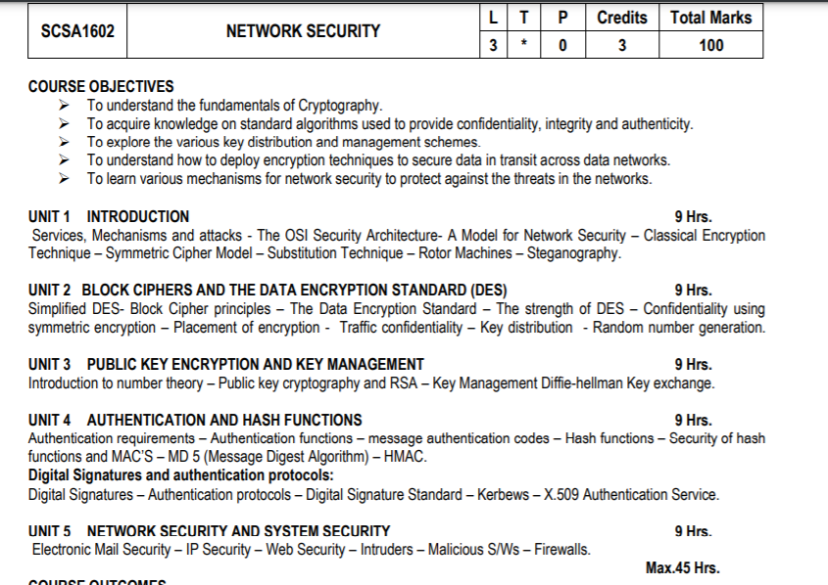
Syllabus

Slide 3
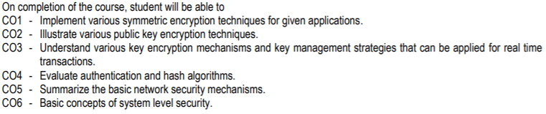
Course Outcomes

Slide 4
What Is Network Security?
Network security refers to the tools, technologies and processes that protect an organization’s network and critical infrastructure from unauthorized use, cyberattacks, data loss and other security threats.
Leverages a combination of advanced technologies and human resources to prevent, detect, contain and remediate a variety of cyber threats.
It will include protection for all hardware systems, software applications and endpoints, as well as the network itself and its various components, including network traffic, data and physical or cloud-based data centers.

Slide 5
What Is Network Security?
Network security has become more important to personal computer users, organizations, and the military.
With the advent of the internet, security became a major concern and the history of security allows a better understanding of the emergence of security technology.
The internet structure itself allowed for many security threats to occur
Measures to protect data during their transmission

Slide 6
Security Attacks, Services And Mechanisms
To assess the security needs of an organization effectively, the manager responsible for security needs some systematic way of defining the requirements for security and characterization of approaches to satisfy those requirements.
One approach is to consider three aspects of information security
Security attack – Any action that compromises the security of information owned by an organization.
Security mechanism – A mechanism that is designed to detect, prevent or recover from a security attack.
Security service – A service that enhances the security of the data processing systems and the information transfers of an organization. The services are intended to counter security attacks and they make use of one or more security mechanisms to provide the service.

Slide 7
SECURITY SERVICES
The classification of security services are as follows:
Confidentiality: Ensures that the information in a computer system and transmitted information are accessible only for reading by authorized parties. Eg., printing, displaying and other forms of disclosure.
Authentication: Ensures that the origin of a message or electronic document is correctly identified, with an assurance that the identity is not false.
Integrity: Ensures that only authorized parties are able to modify computer system assets and transmitted information. Modification includes writing, changing status, deleting, creating and delaying or replaying of transmitted messages.
Non repudiation: Requires that neither the sender nor the receiver of a message be able to deny the transmission.
Access control: Requires that access to information resources may be controlled by or the target system.
Availability: Requires that computer system assets be available to authorized parties when needed.

Slide 8
AUTHENTICATION
The assurance that the communicating entity is the one that it claims to be.
Peer Entity Authentication Used in association with a logical connection to provide confidence in the identity of the entities connected.
Data Origin Authentication In a connectionless transfer, provides assurance that the source of received data is as claimed.

Slide 9
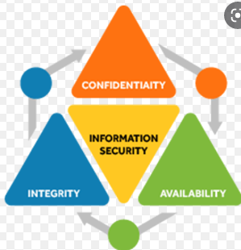
Fundamentals

Slide 10
Confidentiality
Confidentiality is about preventing the disclosure of data to unauthorized parties.
It also means trying to keep the identity of authorized parties involved in sharing and holding data private and anonymous.
Often confidentiality is compromised by cracking poorly encrypted data, Man-in-the-middle (MITM) attacks, disclosing sensitive data.
Standard measures to establish confidentiality include:
Data encryption
Two-factor authentication
Biometric verification
Security tokens

Slide 11
Integrity
Integrity refers to protecting information from being modified by unauthorized parties. Standard measures to guarantee integrity include:
Cryptographic checksums
Using file permissions
Uninterrupted power supplies
Data backups

Slide 12
Availability
Availability is making sure that authorized parties are able to access the information when needed.
Standard measures to guarantee availability include:
Backing up data to external drives
Implementing firewalls
Having backup power supplies
Data redundancy

Slide 13
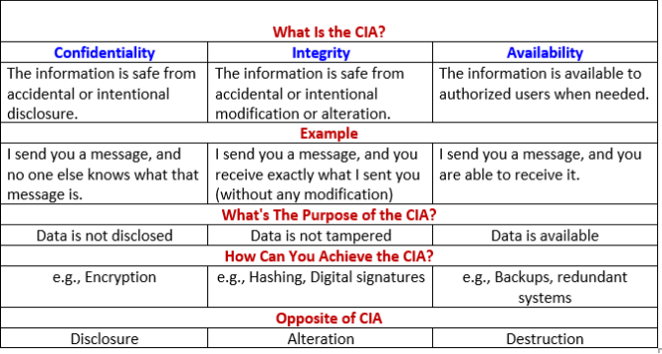

Slide 14
AUTHENTICATION
The confidentiality of selected fields within the user data on a connection or in a single data block.
Traffic Flow Confidentiality The protection of the information that might be derived from observation of traffic flows.
Connection Integrity with Recovery Provides for the integrity of all user data on a connection and detects any modification, insertion, deletion, or replay of any data within an entire data sequence, with recovery attempted.
Connection Integrity without Recovery As above, but provides only detection without recovery.
Selective-Field Connection Integrity Provides for the integrity of selected fields within the user data of a data block transferred over a connection and takes the form of determination of whether the selected fields have been modified, inserted, deleted, or replayed.
Connectionless Integrity Provides for the integrity of a single connectionless data block and may take the form of detection of data modification. Additionally, a limited form of replay detection may be provided.
Selective-Field Connectionless Integrity Provides for the integrity of selected fields within a single connectionless data block; takes the form of determination of whether the selected fields have been modified.

Slide 15
NONREPUDIATION
Provides protection against denial by one of the entities involved in a communication of having participated in all or part of the communication. Nonrepudiation, Origin
Proof that the message was sent by the specified party.
Nonrepudiation, Destination
Proof that the message was received by the specified party.

Slide 16
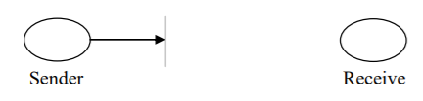
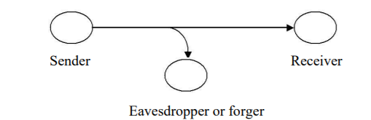
SECURITY ATTACKS
Interruption: An asset of the system is destroyed or becomes unavailable or unusable. This is an attack on availability. e.g., destruction of piece of hardware, cutting of a communication line or disabling of file management system.
Interception:An unauthorized party gains access to an asset. This is an attack on confidentiality. Unauthorized party could be a person, a program or a computer.e.g., wire tapping to capture data in the network, illicit copying of files

Slide 17
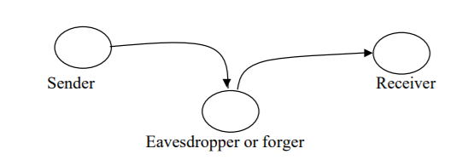
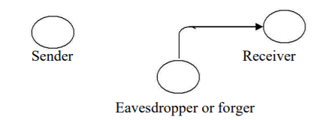
SECURITY ATTACKS
Modification:An unauthorized party not only gains access to but tampers with an asset. This is an attack on integrity. e.g., changing values in data file, altering a program, modifying the contents of messages being transmitted in a network.
Fabrication:An unauthorized party inserts counterfeit objects into the system. This is an attack on authenticity. e.g., insertion of spurious message in a network or addition of records to a file

Slide 18
Passive attack
Passive attacks are in the nature of eavesdropping on, or monitoring of, transmissions. The goal of the opponent is to obtain information that is being transmitted.
Passive attacks are of two types:
Release of message contents: A telephone conversation, an e-mail message and a transferred file may contain sensitive or confidential information. We would like to prevent the opponent from learning the contents of these transmissions.
Traffic analysis: If we had encryption protection in place, an opponent might still be able to observe the pattern of the message. The opponent could determine the location and identity of communication hosts and could observe the frequency and length of messages being exchanged. This information might be useful in guessing the nature of communication that was taking place. Passive attacks are very difficult to detect because they do not involve any alteration of data. However, it is feasible to prevent the success of these attacks.

Slide 19
Active attacks
These attacks involve some modification of the data stream or the creation of a false stream.
These attacks can be classified in to four categories:
Masquerade – One entity pretends to be a different entity.
Replay – involves passive capture of a data unit and its subsequent transmission to produce an unauthorized effect.
Modification of messages – Some portion of message is altered or the messages are delayed or recorded, to produce an unauthorized effect.
Denial of service – Prevents or inhibits the normal use or management of communication facilities. Another form of service denial is the disruption of an entire network, either by disabling the network or overloading it with messages so as to degrade performance.
It is quite difficult to prevent active attacks absolutely, because to do so would require physical protection of all communication facilities and paths at all times. Instead, the goal is to detect them and to recover from any disruption or delays caused by them.

Slide 20
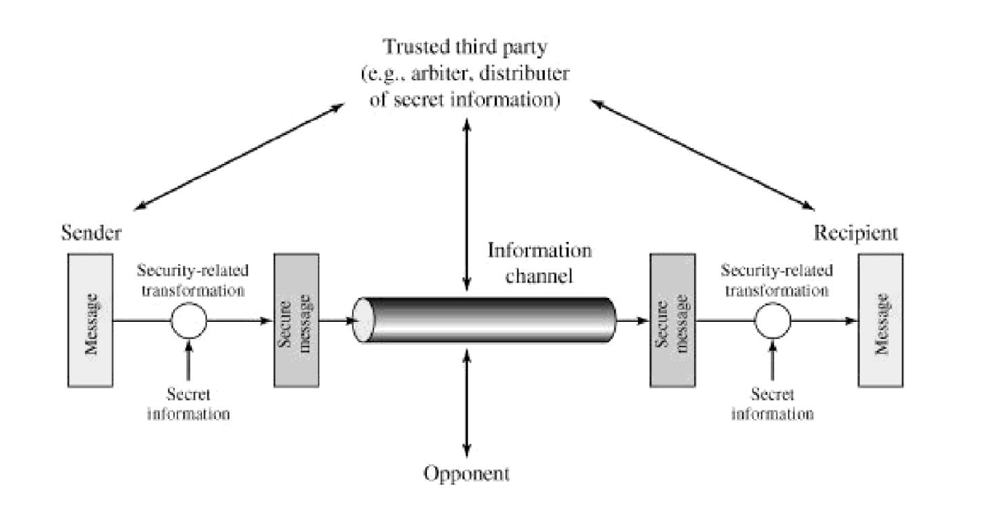
A MODEL FOR NETWORK SECURITY

Slide 21
A message is to be transferred from one party to another across some sort of internet.
The two parties, who are the principals in this transaction, must cooperate for the exchange to take place.
A logical information channel is established by defining a route through the internet from source to destination and by the cooperative use of communication protocols (e.g., TCP/IP) by the two principals.
Security aspects come into play when it is necessary or desirable to protect the information transmission from an opponent who may present a threat to confidentiality, authenticity, and so on.
A security-related transformation on the information to be sent.
Examples include the encryption of the message, which scrambles the message so that it is unreadable by the opponent, and the addition of a code based on the contents of the message, which can be used to verify the identity of the sender Some secret information shared by the two principals and, it is hoped, unknown to the opponent.
An example is an encryption key used in conjunction with the transformation to scramble the message before transmission and unscramble it on reception.

Slide 22
Tasks in designing a particular security service
Design an algorithm for performing the security-related transformation. The algorithm should be such that an opponent cannot defeat its purpose.
Generate the secret information to be used with the algorithm.
Develop methods for the distribution and sharing of the secret information.
Specify a protocol to be used by the two principals that makes use of the security algorithm and the secret information to achieve a particular security service.

Slide 23
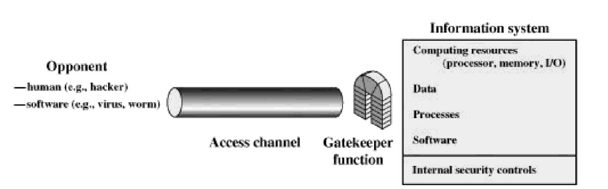
Network Access Security Model

Slide 24
CLASSICAL ENCRYPTION TECHNIQUES
The Process of converting from plaintext to ciphertext is known as enciphering or encryption.
Restoring the plaintext from the ciphetext is deciphering or decryption.
The many schemes used for encryption constitute the area of study known as cryptography.
Techniques used for deciphering a message without any knowledge of the enciphering details is known as cryptanalysis. It also known as "Breaking the Code".
The areas of cryptography and cryptanalysis together are called cryptology.
A cryptanalyst develops mathematical methods and codes that protect data from computer hackers.
This involves the decryption of a cipher text into plain text in order to transmit a message over insecure channels.

Slide 25
CLASSICAL ENCRYPTION TECHNIQUES
Symmetric Cryptography: In the symmetric cryptography a single key is used for encrypting and decryption the data. ...
Asymmetric Cryptography: In the asymmetric cryptography a pair of key, i.e., public key and private key is used for encryption and decryption.

Slide 26
Symmetric cipher model
Symmetric encryption is a form of cryptosystem in which encryption and decryption are performed using the same key. It is also known as conventional encryption.
Symmetric encryption transforms plaintext into cipher text using a secret key and an encryption algorithm.
Using the same key and a decryption algorithm, the plaintext is recovered from the cipher text. A symmetric encryption scheme has five ingredients

Slide 27
Symmetric cipher model
Plaintext: This is the original intelligible message or data that is fed into the algorithm as input.
Encryption algorithm: The encryption algorithm performs various substitutions and transformations on the plaintext.
Secret key: The secret key is also input to the encryption algorithm. The key is a value independent of the plaintext and of the algorithm.
Ciphertext: This is the scrambled message produced as output. It depends on the plaintext and the secret key. The ciphertext is an apparently random stream of data and, as it stands, is unintelligible.
Decryption algorithm: This is essentially the encryption algorithm run in reverse. It takes the ciphertext and the secret key and produces the original plaintext.

Slide 28
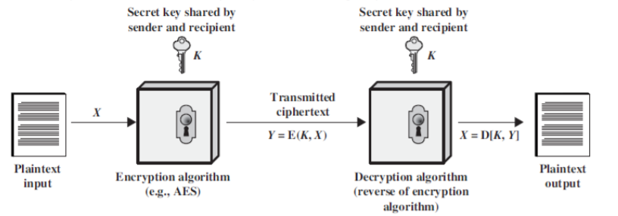
Symmetric cipher model

Slide 29
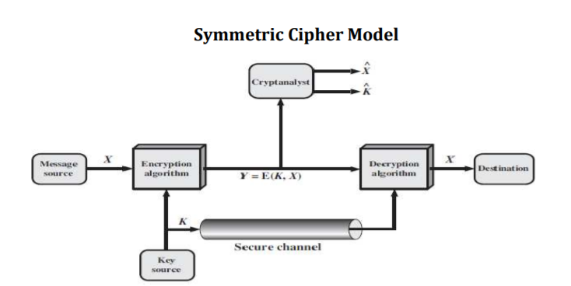
Symmetric cipher model

Slide 30
Symmetric cipher model
A symmetric cipher model are broadly contains five parts.
Plaintext: This is the original intelligible message.
Encryption algorithm: The encryption algorithm performs various substitutions and transformations on the plaintext. It takes in plaintext and key and gives the cipher text.
Secret key: The key is a value independent of the plaintext and of the algorithm. Different keys will yield different outputs.
Ciphertext: This is the scrambled message produced as output. It depends on the plaintext and the secret key.
Decryption algorithm: Runs on the cipher text and the key to produce the plaintext.This is essentially the encryption algorithm run in reverse.

Slide 31
Two basic requirements of encryption
Encryption algorithm should be strong. An attacker knowing the algorithm and having any number of cipher text should not be able to decrypt the cipher text or guess the key.
The key shared by the sender and the receiver should be secret.

Slide 32
Symmetric cipher model
Let the plaintext be X = [X1, X2,…, XM], key be K = [K1, K2,…, KJ] and the cipher text produced be Y = [Y1, Y2,…, YN]. Then, we can write 𝑌 = 𝐸(𝐾, X)
Here E represents the encryption algorithm and is a function of plaintext X and key K.
The receiver at the other ends decrypts the cipher text using the key. X = 𝐷(𝐾, 𝑌)
Here D represents the decryption algorithm and it inverts the transformations of encryption algorithm.
An opponent not having access to X or K may attempt to recover K or X or both.
It is assumed that the opponent knows the encryption (E) and decryption (D) algorithms.
If the opponent is interested in only this particular message, then the focus of the effort is to recover by generating a plaintext estimate^X.
If the opponent is interested in being able to read future messages as well then he will attempt to recover the key by making an estimate ^𝐾.

Slide 33
Cryptographic systems are characterized along three independent dimensions
The types of operations used for transforming plaintext to ciphertext. All encryption algorithms are based on two general principles substitution, and transposition. Basic requirement is that no information be lost. Most systems referred to as product system, involves multiple stages of substitutions and transpositions.
2. The number of keys used. If both sender and receiver use the same key, the system is referred to as symmetric, single-key, secret-key, or conventional encryption. If the sender and receiver use different keys the system is referred to as asymmetric, two-key, or public-key encryption.
3. The way in which the plaintext is processed. A block cipher process a block at a time and produce an output block for each input block. A stream cipher process the input element continuously, producing output one element at a time, as it goes along.

Slide 34
Cryptanalysis and Brute-Force Attack
Cryptanalysis: Cryptanalytic attacks rely on the nature of the algorithm plus perhaps some knowledge of the general characteristics of the plaintext or even some simple plaintext-ciphertext pairs. This type of attack finds characteristics of the algorithm to find a specific plaintext or to find key.
Brute-force attack: The attacker tries every possible key on a piece of ciphertext until plaintext is obtained. On average, half of all possible keys must be tried to achieve success.
Based on the amount of information known to the cryptanalyst cryptanalytic attacks can be categorized as:
Cipher text Only Attack: The attacker knows only cipher text only. It is easiest to defend.
Known plaintext Attack: In this type of attack, the opponent has some plaintext-cipher text pairs. Or the analyst may know that certain plaintext patterns will appear in a message. For example, there may be a standardized header or banner to an electronic funds transfer message and the attacker can use that for generating plaintext-cipher text pairs.

Slide 35
Cryptanalysis and Brute-Force Attack
Chosen plaintext: If the analyst is able somehow to get the source system to insert into the system a message chosen by the analyst, then a chosen-plaintext attack is possible. In such a case, the analyst will pick patterns that can be expected to reveal the structure of the key.
o Chosen Cipher text: In this attack, the analyst has cipher text and some plaintext-cipher text pairs where cipher text has been chosen by the analyst.
o Chosen Text: Here, the attacker has got cipher text, chosen plaintext-cipher text pairs and chosen cipher text-plaintext pairs.
Chosen cipher text and chosen text attacks are rarely used.
It is assumed that the attacker knows the encryption and decryption algorithms.
Generally, an encryption algorithm is designed to withstand a known-plaintext attack.

Slide 36
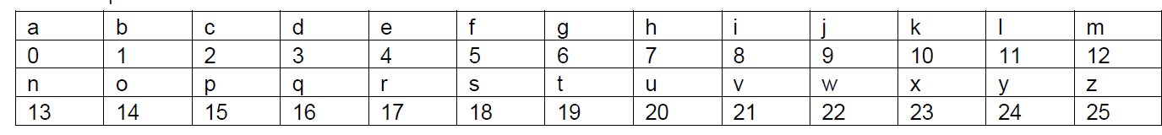
Substitution Techniques
It is one in which the letters of plaintext are replaced by other letters or by numbers or symbols
Caesar cipher
E(𝑝) = (𝑝 + 𝑘) mod (26) D(C) = (C – 𝑘) mod (26)

Slide 37
Caesar cipher
Example 1: Hello
Example 3: sathyabama
Example 2: Plaintext: meet me after the party
The encryption rule is simple; replace each letter of the alphabet with the letter standing 3 places further down the alphabet.
The alphabet is wrapped around so that Z follows A.
Generally Plain text is in lower case and Cipher text is Upper Case.

Slide 38
Monoalphabetic Substitution Cipher
Instead of shifting alphabets by fixed amount as in Caesar cipher, any random permutation is assigned to the alphabets. This type of encryption is called monoalphabetic substitution cipher.
For example, A is replaced by Q, B by D, C by T etc. then it will be comparatively stronger than Caesar cipher.
The number of alternative keys possible now becomes 26!.
Thus, Brute Force attack is impractical in this case.

Slide 39
Monoalphabetic Substitution Cipher
However, another attack is possible. Human languages are redundant i.e. certain characters are used more frequently than others. This fact can be exploited.
In English ‘e’ is the most common letter followed by ‘t’, ‘r’, ‘n’, ’o’, ‘a’ etc. Letters like ‘q’, ‘x’, ‘j’ are less frequently used.
Moreover, digrams like ‘th’ and trigrams like ‘the’ are also more frequent.
Tables of frequency of these letters exist. These can be used to guess the plaintext if the plaintext is in uncompressed English language.
The most common two letter combinations are called as digrams. e.g. th, in, er, re and an.
The most common three letter combinations are called as trigrams. e.g. the, ing, and, and ion

Slide 41
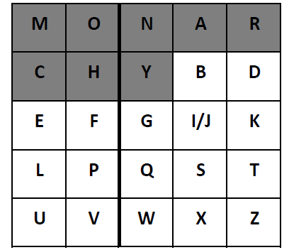
Playfair Cipher
The plaintext is encrypted two letters at a time:
Break the plaintext into pairs of two consecutive letters.
If a pair is a repeated letter, insert a filler like ‘X‘in the plaintext, eg. "Balloon" is treated as "ba lx lo on". If both letters fall in the same row of the key matrix, replace each with the letter to its right (wrapping back to start from end), eg. “AR" encrypts as "RM".
o If both letters fall in the same column, replace each with the letter below it (again wrapping to top from bottom), eg. “MU" encrypts to "CM".
o Otherwise each letter is replaced by the one in its row in the column of the other letter of the pair, eg. “HS" encrypts to "BP", and “EA" to "IM" or "JM" (as desired)
• Security is much improved over monoalphabetic as here two letters are encrypted at a time and hence there are 26 X 26 =676 diagrams and hence it needs a 676 entry frequency table

Slide 42
Polyalphabetic Ciphers
A polyalphabetic substitution cipher is any substitution-based cipher that uses multiple mono substitution alphabets.
Vignere cipher
Vernam Cipher

Slide 43


Slide 44
Steganography
Steganography is the embedding of messages within an innocuous cover work in a way which can not be detected1 by anyone without access to the appropriate steganographic key
Cover image: Image steganography system implants its secret in an image known as a cover image.
Message: Original information that the system hides into the cover image.
Stego-image: Stego-image contains the implanted secret information.
Stego-key: For embedding or extracting the message in cover-images and from stego images, the algorithm uses a key, called stego key.
Embedding procedure: A set of rules which implants a secret message in an image.
Extracting procedure: The process of recovering a secret message from the stego image.

Slide 45
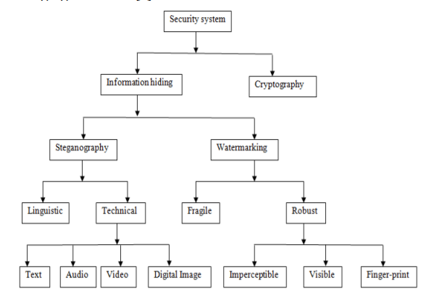
Security System

Slide 46
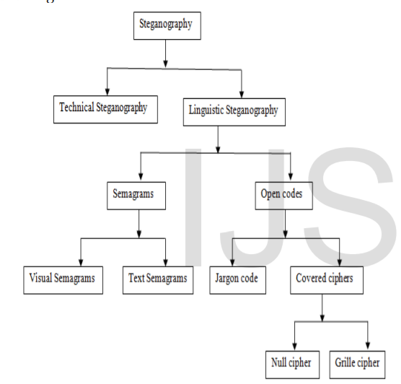
Classification: Steganography

Slide 47
Classification: Steganography
TECHNICAL STEGANOGRAPHY:To conceal the existence of a message using physical or chemical means is called technical steganography. Examples of this type of steganography include invisible ink or microdots and other size-reduction methods
LINGUISTIC STEGANOGRAPHY: Linguistic steganography is a branch of steganography in which embed the messages into cover and make stego. In the resulting stego, without actual recipient, no one easily finds the presence of the real information. In this steganography, the idea is to hide the presence of the actual messages. It hides the messages in natural language

Slide 48
Classification: Linguistic Steganography
Semagrams hide information by the use of symbols or signs in visually or text. Semagrams is classified into visual semagrams and text semagrams.
In visual semagrams, the physical object is used to embed secret data in such a way that only actual recipient can understand not another one. To hide the message semagrams used different symbol and sign of the particular language
Text semagrams, modifying the appearance of text to embed the secret information. Modifying the appearance means changes in the font size, color, height and width of letters, add extra space, add extra letters, etc.
Open codes are used to hide the secret message invisibly to the outsider. Open code is categorized in two ways: jargon codes and covered cipher.

Slide 49
Classification: Linguistic Steganography
In jargon code, information is embedded using the properties of the particular language. The people who are known with that particular language, only they can understand the embedded information.
In covered ciphers, secret information is embedded openly. So, if anyone knows the method of embedding, then it can be possible to recover the information. Covered ciphers can classify as a null cipher and grille cipher.
In grille cipher, secret information is embedded into a template. The words that appear in the openings of the template are the hidden message.
In null cipher, some predefined set of rules are used to implant the secret information. “Read the second character in every word” is one kind of predefined rule

Slide 50
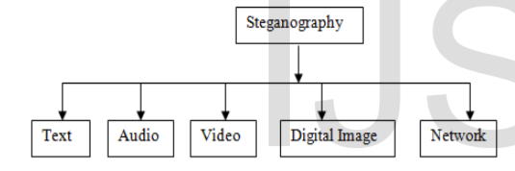
CLASSIFICATION OF STEGANOGRAPHY BASED ON CARRIER FILE
Carrier file means the file which is used to carry the secret
message.

Slide 51
CLASSIFICATION OF STEGANOGRAPHY BASED ON CARRIER FILE
Text steganography is a technique where the text file is used as a carrier. In this methods, hiding the message of one text into another one for secure communication.
Network steganography allows users to communicate secretly by embedding information within other messages. Steganophony, Transcoding steganography, lost audio packets steganographic method, Stream Control Transmission Protocol, etc. are network steganography
When an audio file is used as a carrier to implant a message, then this is called audio steganography. Audio files may be modified in such a way that they contain hidden information in such a way that it is difficult to remove the hidden data without destroying the original signal
A video consists both of images and audio. When this video file is used as a carrier, then this steganography is called video steganography. The video steganography technique is almost similar to image and audio steganographic techniques. Using a video file, a large amount of data can be implanted, but the problem is the size of such file and also the time computation.
When taking the cover file as the image in steganography is called image steganography. Images are the most popular and useful cover image for steganography

Slide 52
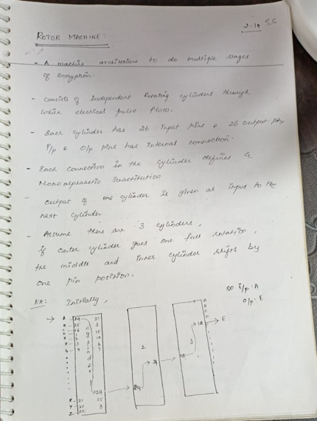

Slide 53
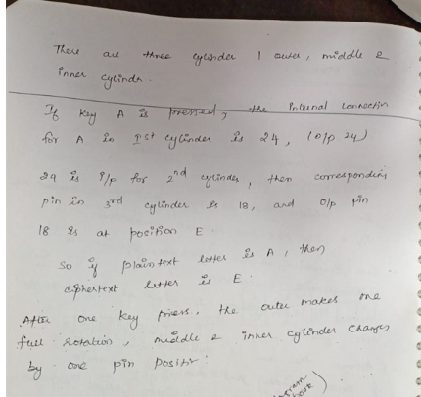

Slide 54
